Slide 1

Icare System

Slide 2
1. Introduction
Today's world is driven by data and everyday the standard to handle that data in everyday life increases
Therefore, businesses must adopt ways to handle the data well that’s where the Icare system comes in
Icare provide an application for clinics of small to medium size that will provide the core necessary functions the establishment would need without any over the board capabilities that won’t be utilized

Slide 3
System analysis
Project Scope:
The scope of the project is to design a desktop application that can provide the core functions in a lightweight and cost-effective way for small to medium size clinics.
System Requirements :
Every system needs its requirements set out to be able to know if they match the needs of the stakeholders and clients and there are two kinds of requirements :
Functional requirements : explain how the system must work
Non-functional requirements : explain how the system should perform.

Slide 4
Functional and non-functional requirements
Functional
Non-functional
Sign in/out
Log sign ins/outs
Change user information
Add patients
Book appointments
Make sure approximants don’t overlap by doctor or time
Look and feel requirements :
The Application should give clear and straightforward feedback to the
Usability requirements :
The application should be easy to use and have clear interfaces to make sure the user does not get confused or frustrated.
Security requirements :
Users should not have the ability to see interfaces they do not have permission for example receptionist should not have the ability to complete the operations that the manger has the rights to.

Slide 5
Design Considerations
Software environment :
JavaFX
MySQL
Juint
Java
End-User Characteristics:
The targeted audience of this system are clinic office personnel such as the owner, manger, and receptionist as they will provide services for the doctors and patients.

Slide 6
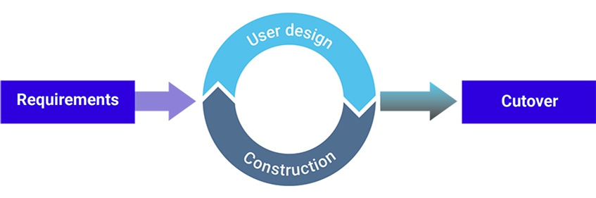
Project Management Strategies
In this project we used the rapid application development methodology :
Rapid application development (RAD) is a condensed development process that produces a high-quality system with low investment costs
The rapid application development method contains four phases: requirements planning, user design, construction, and cutover. The user design and construction phases repeat until the user confirms that the product meets all requirements.

Slide 7
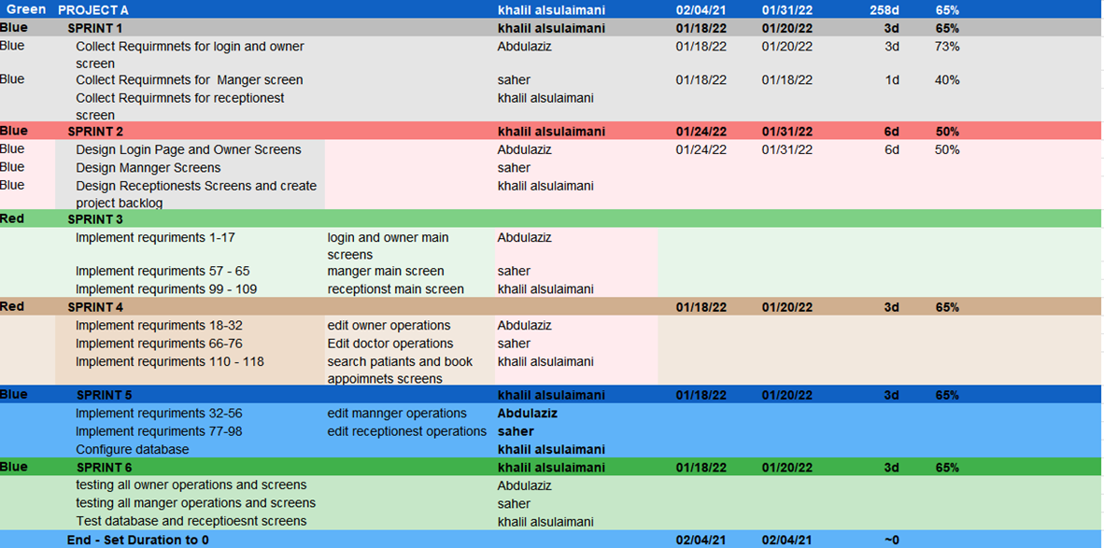
Gannet Chart
A Gantt chart is a project management tool assisting in the planning and scheduling of projects of all sizes, although they are particularly useful for simplifying complex projects.

Slide 8
System design
System design is the process of designing the elements of a system such as the architecture, modules and components, the different interfaces of those components and the data that goes through that system.
The most often used tool for this is UML:
UML : Unified Modeling language is a standardized modeling language enabling developers to specify, visualize, construct and document artifacts of a software system.

Slide 9
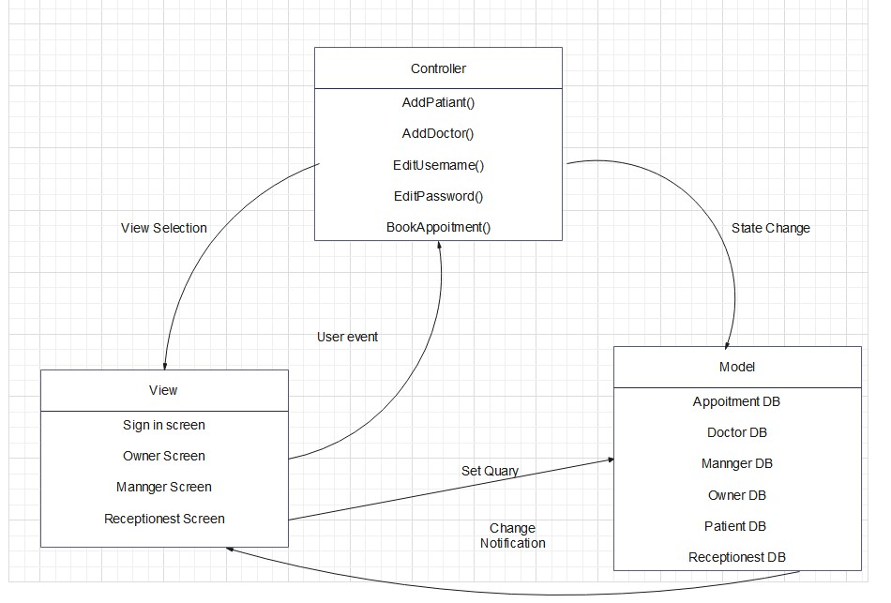
MVC Model
The Model View Controller (MVC) design pattern specifies that an application consist of a data model, presentation information, and control information. The pattern requires that each of these be separated into different objects.

Slide 10
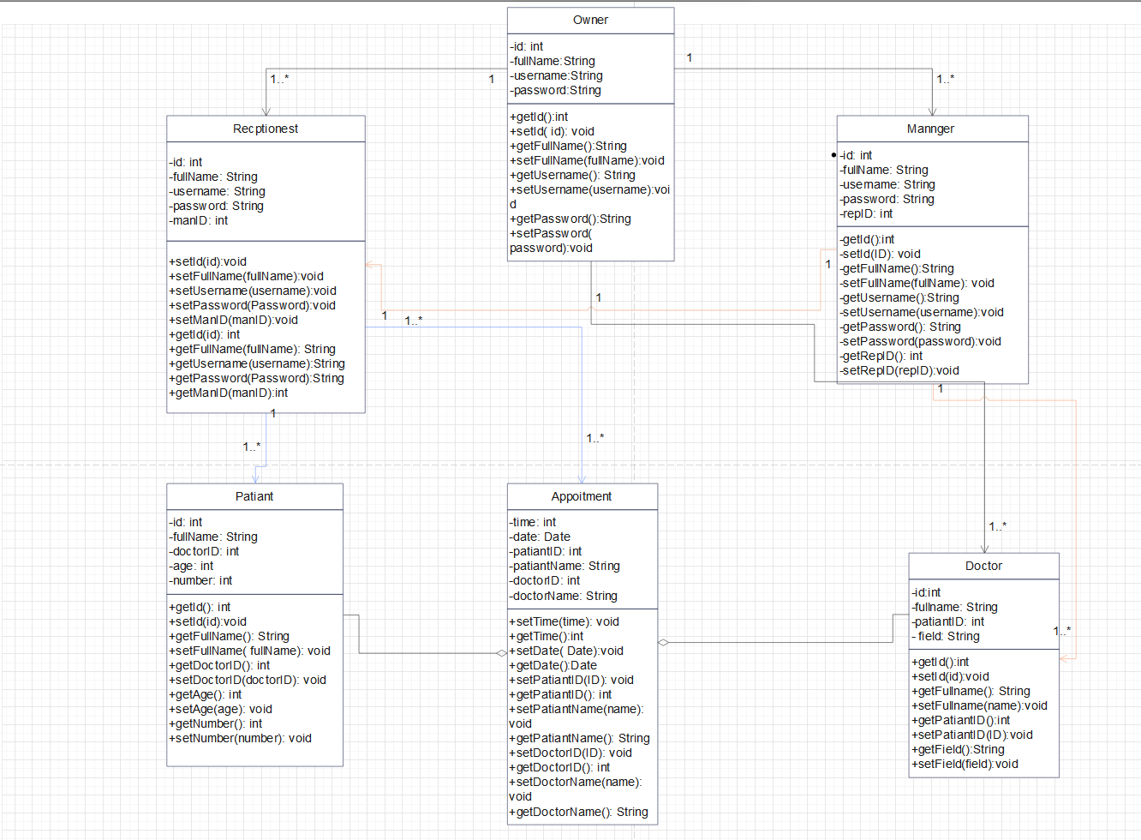
Class diagram
A class diagram is a type of diagram and part of a unified modeling language (UML) that defines and provides the overview and structure of a system in terms of classes, attributes and methods, and the relationships between different classes.

Slide 11
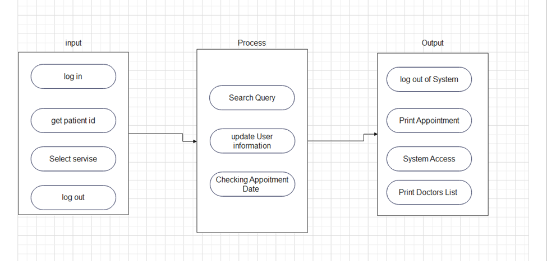
Software Architecture Diagram
Software architecture is the defining and structuring of a solution that meets technical and operational requirements. Software architecture optimizes attributes involving a series of decisions, such as security, performance, and manageability. These decisions ultimately impact application quality, maintenance, performance, and overall success.

Slide 12
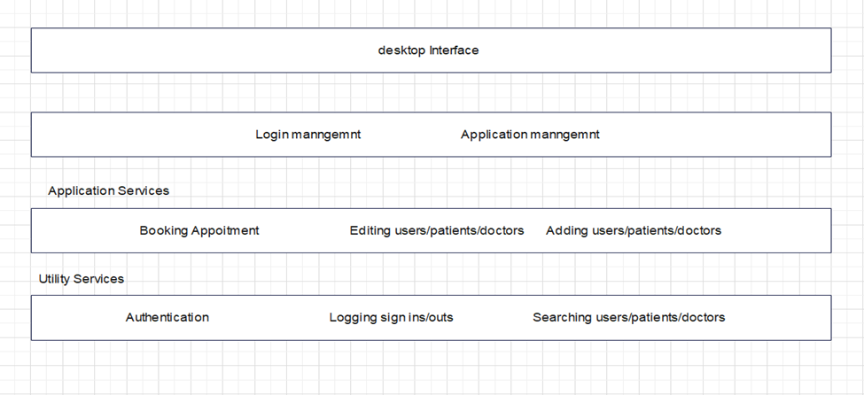
Layered Architecture Diagram
Layered architectures are said to be the most common and widely used architectural framework in software development. It is also known as an n-tier architecture and describes an architectural pattern composed of several separate horizontal layers that function together as a single unit of software.

Slide 13
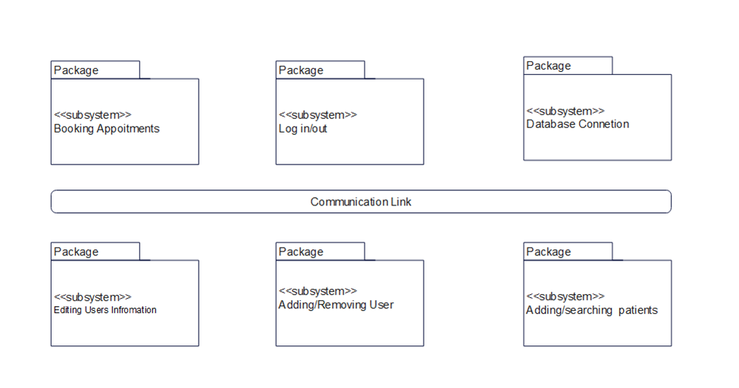
The Component and Link Diagram
A link component is a reusable link definition that can be used to describe how various values returned by one operation can be used as input for other operations. In this way, links provide a known relationship and traversal mechanism between the operations.

Slide 14
Implementation
In the next slides we will show how we implemented the application from the start up to how we coded some of the main functionality like logging and singing in for the different users.

Slide 15
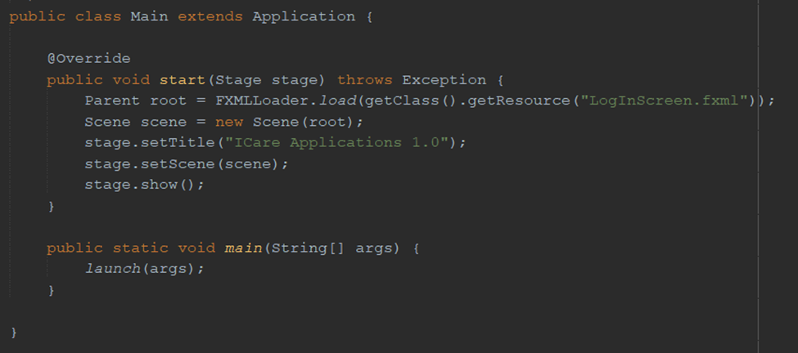
Main Method
The main method Inherits from the Application class to provide the start up to the application, where using the FXMLLoeader we can provide the fxml file we want to show at the start .
The fxml files contain the visual elements and settings whereas there is another class tied to each fxml that is called a controller that’s how this project is laid out

Slide 16
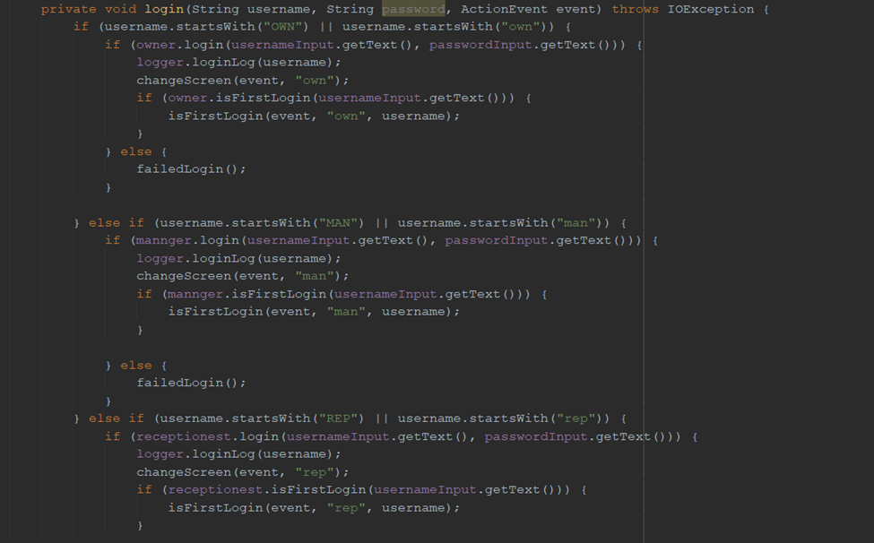
Login Method:
The login method is inside the login Controller class and when the user clicks the login button the method is called, when its called it reads the prefix of the username and compares it to the user prefixes, we specified in the Req002a.

Slide 17
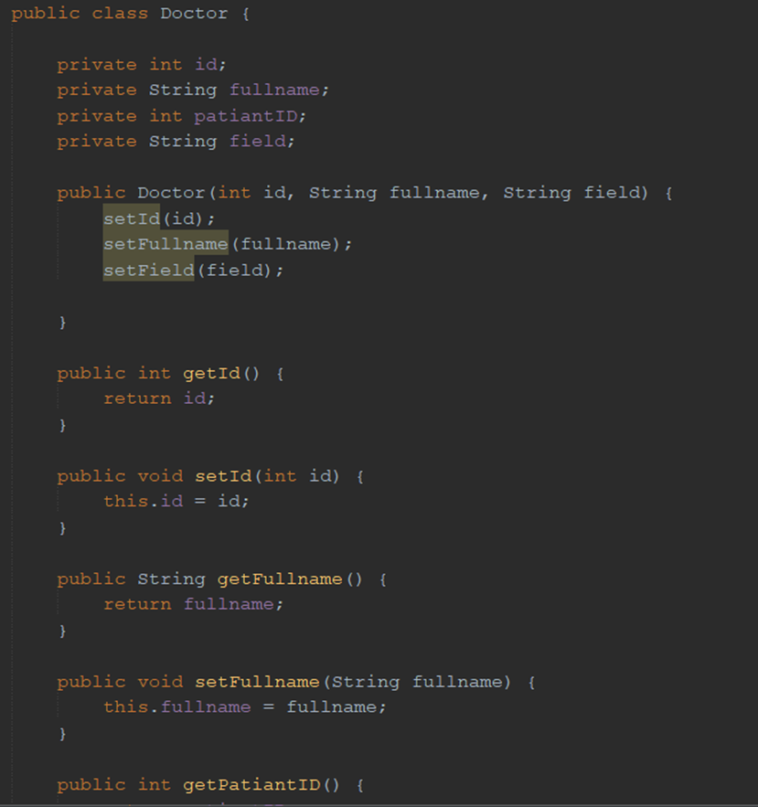
The Object class
The object class is your standard OOP Object class containing the main variables of that object and the corresponding constructor and setter and getter classes.

Slide 18
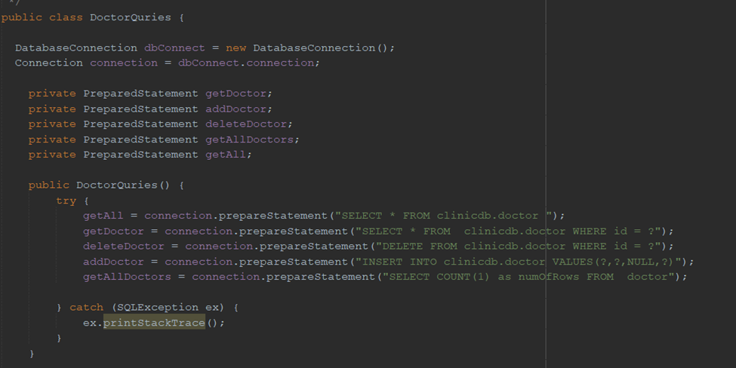
The ObjectQuries classes
The objectQuries classes will have a connection variable that will allow it to connect to the database, after successful connection the class has several methods that use Prepared statements that have been set as variables but missing the needed information from the user which will be given by the user at run time to execute the query.

Slide 19

Thank you for listening

